Slide 1





Visualización de Datos y Narración de Historias
02 Técnicas y Herramientas para la Visualización de Datos
Edgar Avalos-Gauna, PhD.
edgaravalos@up.edu.mx
www.linkedin.com/in/e-avalos-gauna/

Slide 2

Visualization gives you answers to questions you didn’t know you had.
Ben Schneiderman
Professor at University of Maryland Department of Computer Science

Slide 3
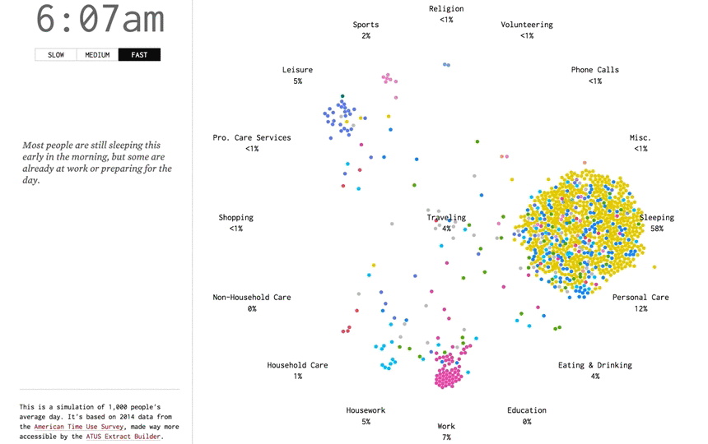
A Day in the Life of Americans, https://flowingdata.com/2015/12/15/a-day-in-the-life-of-americans/
https://www.youtube.com/watch?v=wHiOYjDCMZI

Slide 4
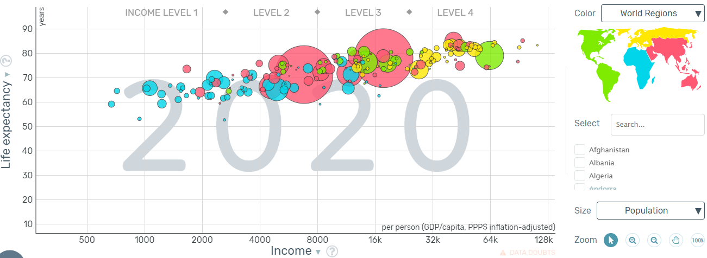
https://www.gapminder.org/

Slide 5
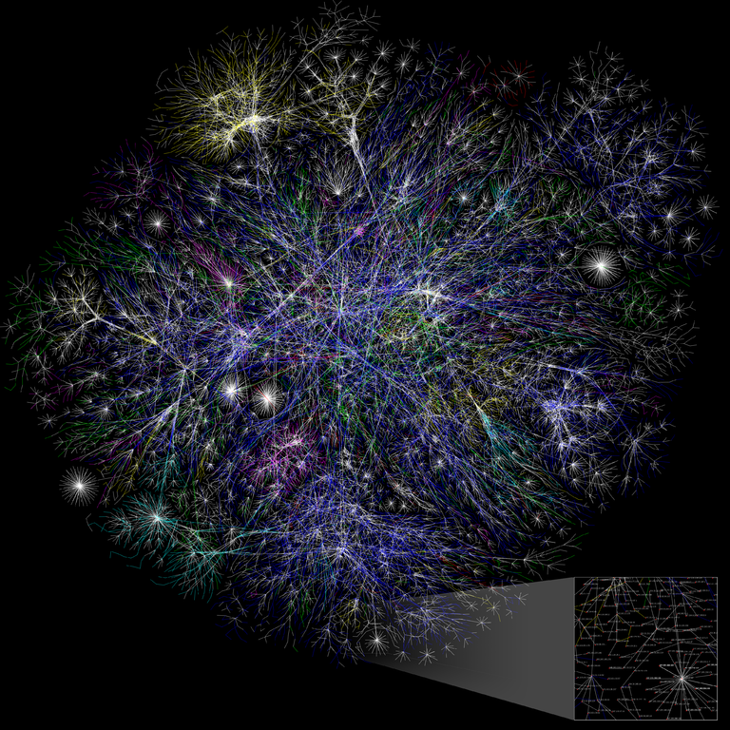
Visualization
Definition
The act of making
something able to be seen by the eye
Barrett Lyon,
https://www.opte.org/the-internet

Slide 6
¿Qué otros ejemplos conoces?

Slide 7
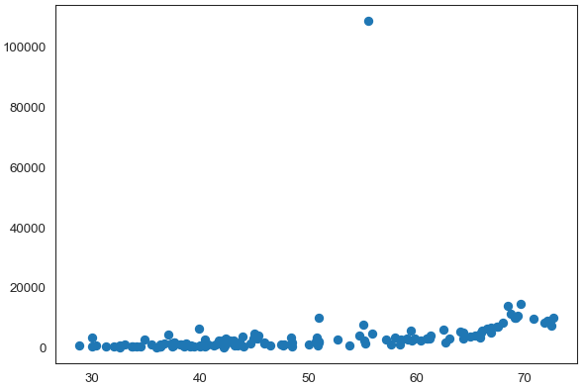
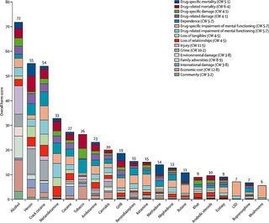
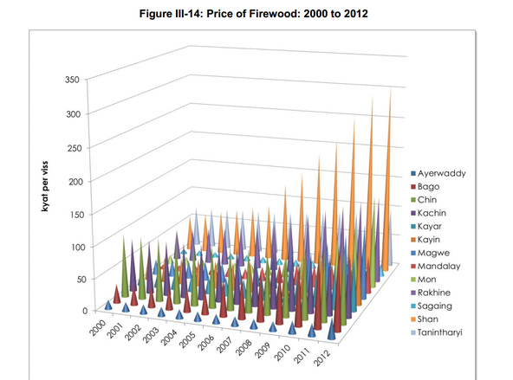
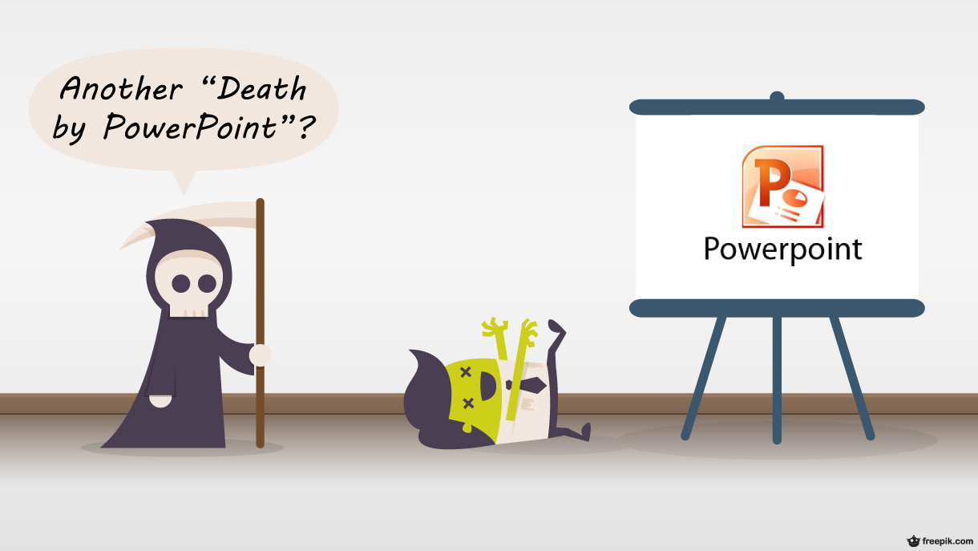
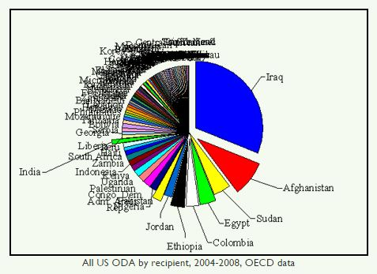

Slide 8

The DIKW pyramid
Understanding
Integrated
Actionable
Wisdom
Knowledge
Information
Data
Storytelling
Contextualized Synthetized Learning
Connect to
a framework
Experience
Useful, Organized and Structured
Summarize
Raw records and features with low level of understanding
Berengueres, A. F. J., & Sandell, M. (2019). Introduction to Data Visualization & Storytelling A Guide For The Data Scientist.
Frické, M. (2009). The knowledge pyramid: a critique of the DIKW hierarchy. Journal of information science, 35(2), 131-142.

Slide 9
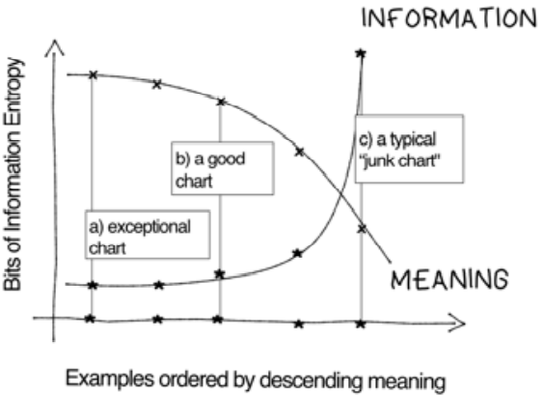
MacLeod, H. (2009). Ignore Everybody: And 39 Other Keys to Creativity. Penguin.

Slide 10
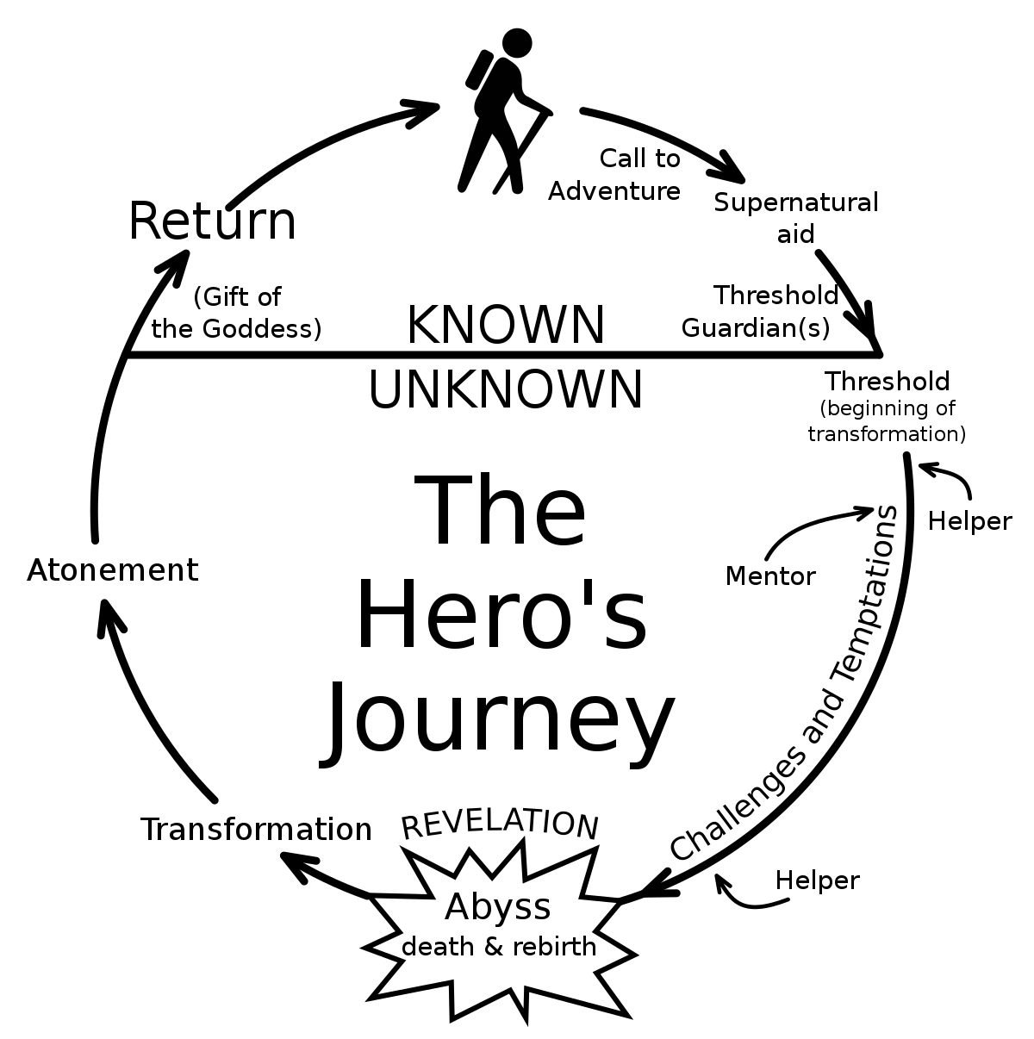
Narrative
A way of presenting or understanding a situation or series of events that reflects and promotes a particular point of view or set of values
https://www.merriam-webster.com/dictionary/narrative

Slide 11
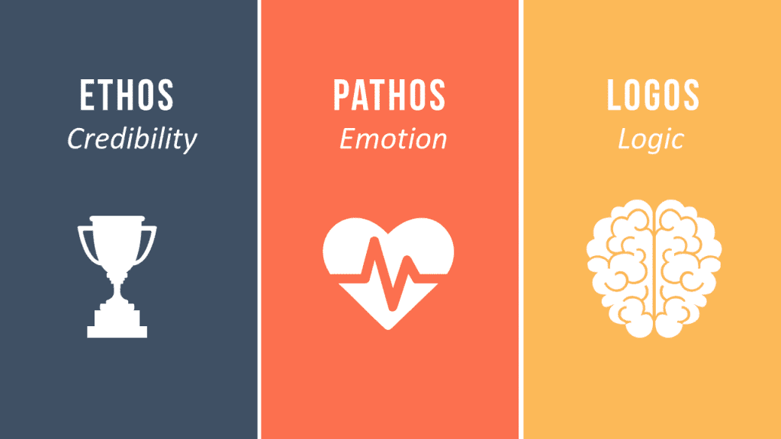
Aristotle and the 3 Methods of Persuasion

Slide 12

Aristotle 3 modes of persuasion
Ethos (Ethical values)
Pathos (Emotions)
Logos (Logic)

Slide 13
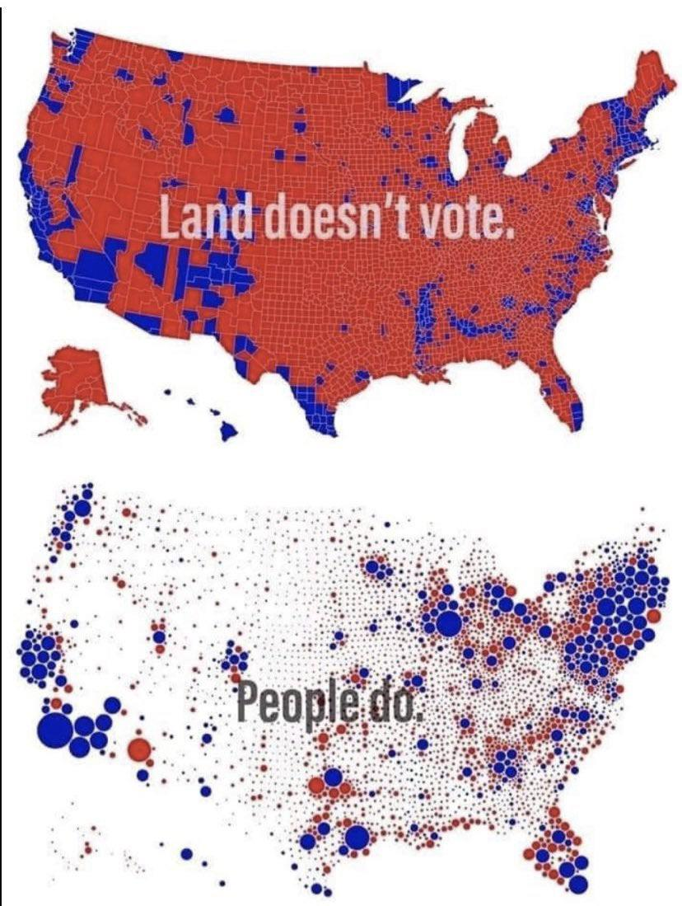
Deceiptive charts
Dual y-axis
Non-zero baseline
Stretched proportions

Slide 14
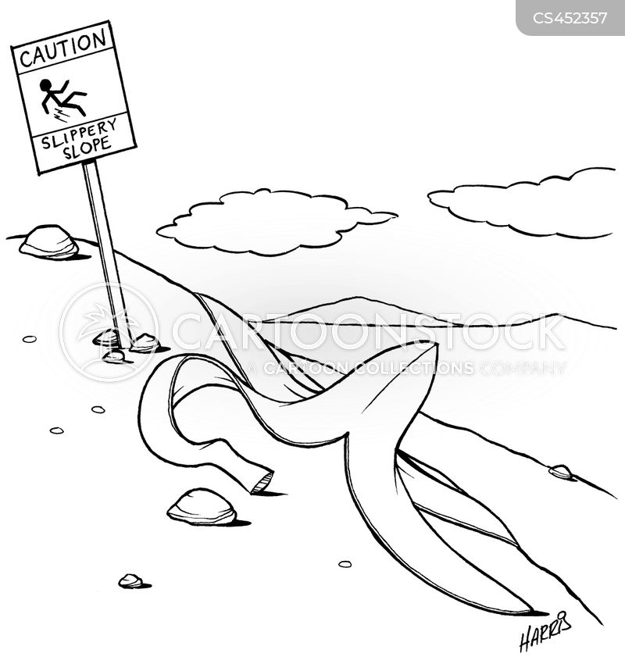
Common Fallacies With Data

Slide 15
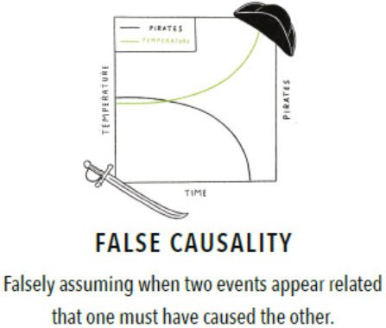
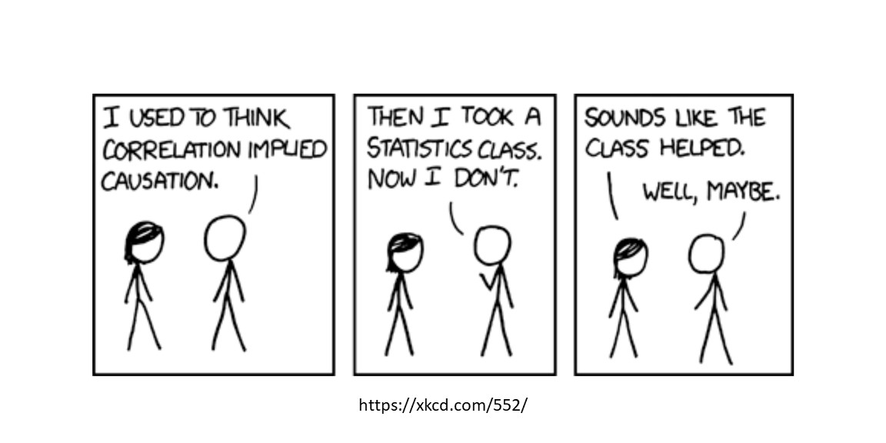
Spurious correlations

Slide 16
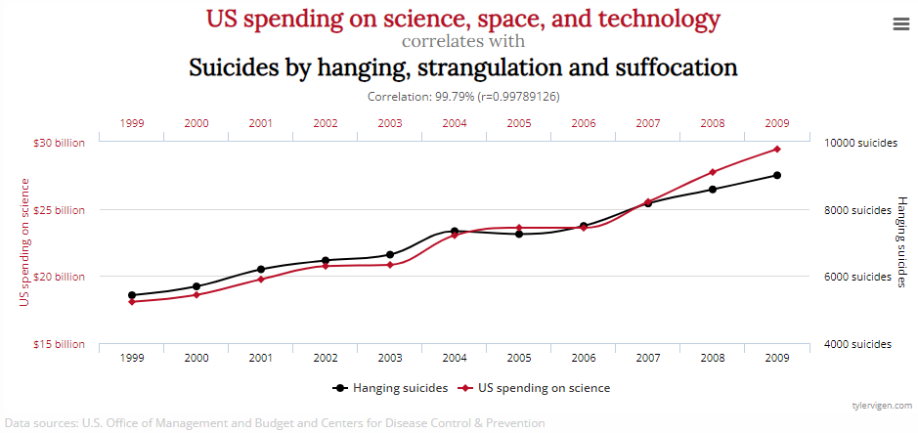
Spurious Correlations
http://www.tylervigen.com/spurious-correlations

Slide 17
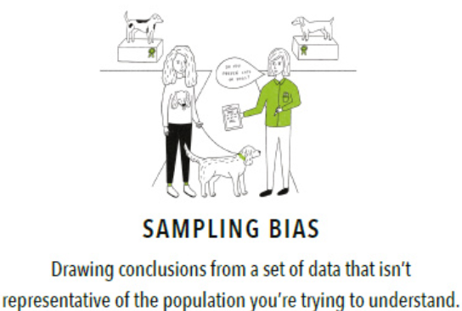
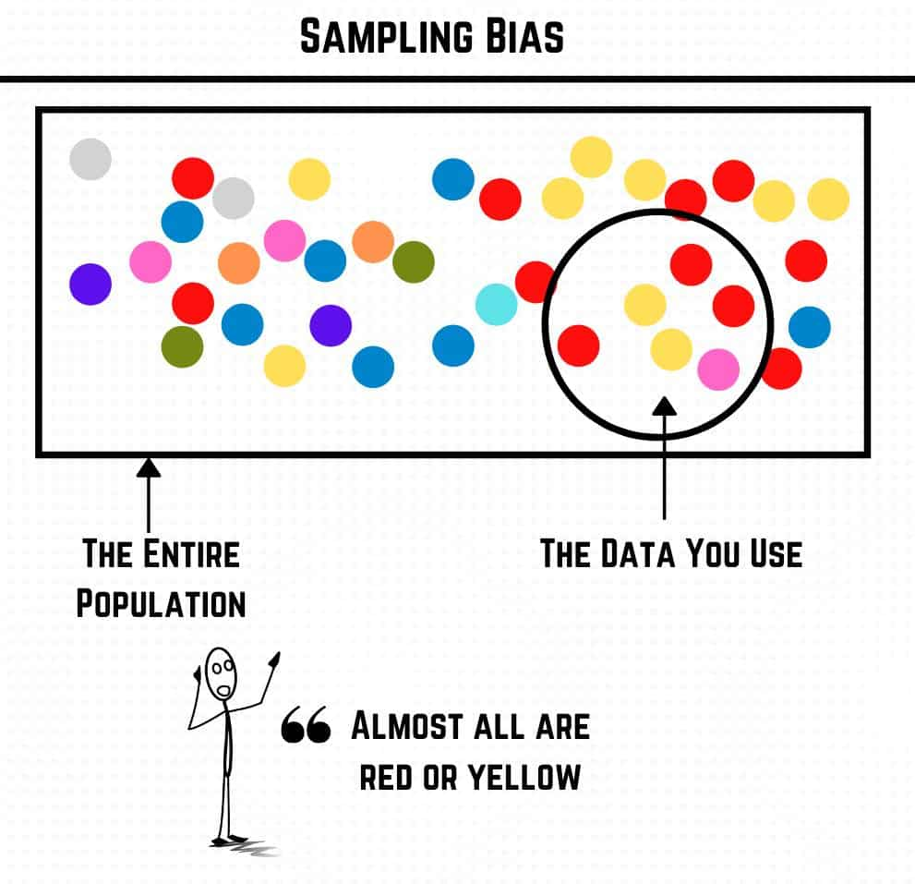
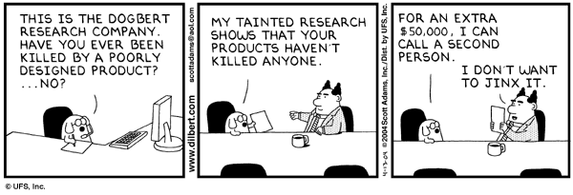

Slide 18

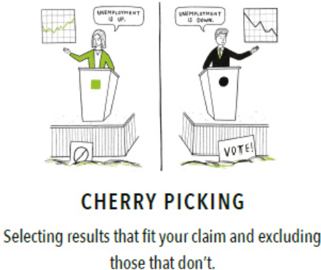

Slide 19
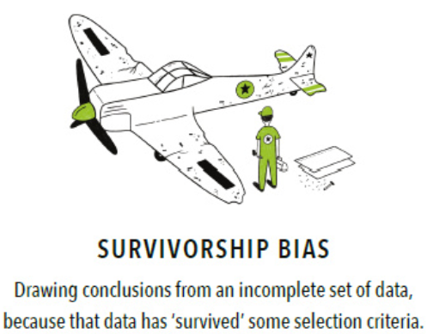
“Steve Jobs, Bill Gates, and Mark Zuckerberg dropped out of college and became millionaires, so will I.”
“If I read the biographies of the world’s most successful entrepreneurs, I’ll understand how to be successful.”
“My product is better than their product, so I’ll succeed.”
“Sales team X used these email templates to increase close rates by 35%. I’ll use these templates and get the same results.”
“If I focus on my unhappy customers, I’ll be able to retain them and decrease my churn rate.”
“Our customers are requesting these features; we should add them to our product/service.”

Slide 20
Huracan Katia, 2011
Origin:
27 August 2011
Close to Bermudas:
5 September 2011
What will happen next?

Slide 21
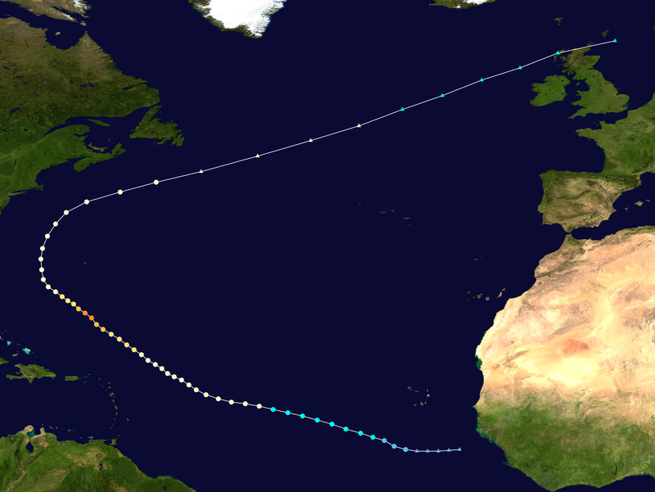
Huracan Katia, 2011
Always be aware of the full picture!

Slide 22
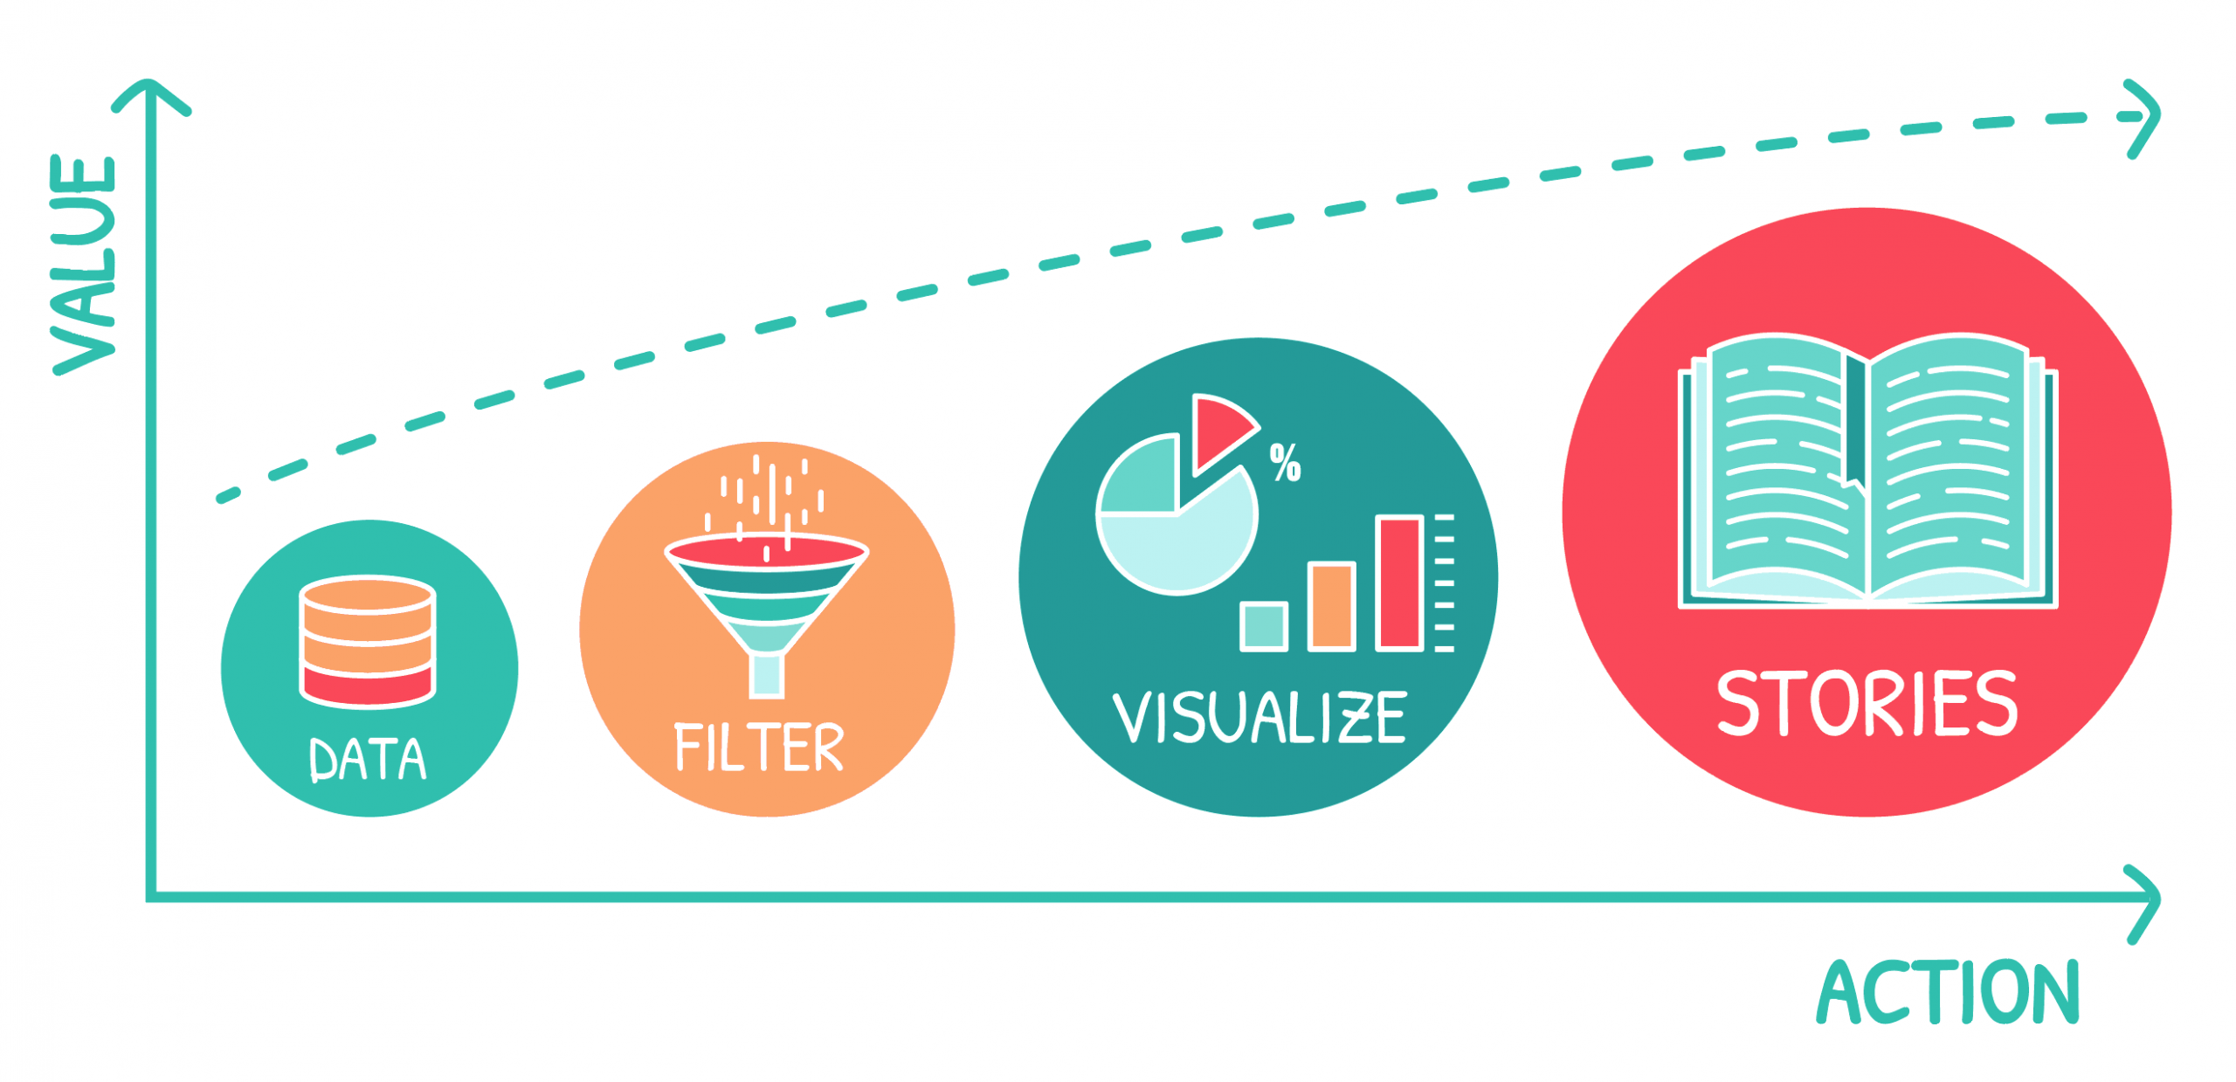
Data Storytelling

Slide 23
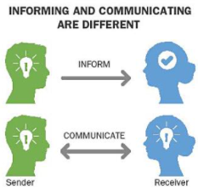
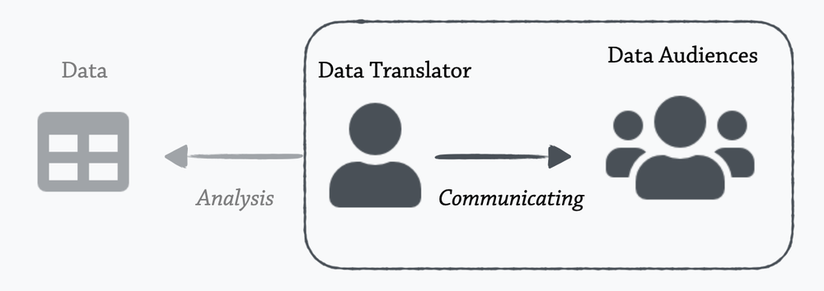
Inform
&
Communicate

Slide 24
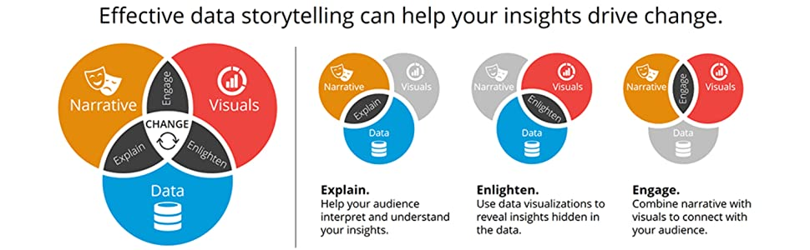

Slide 25
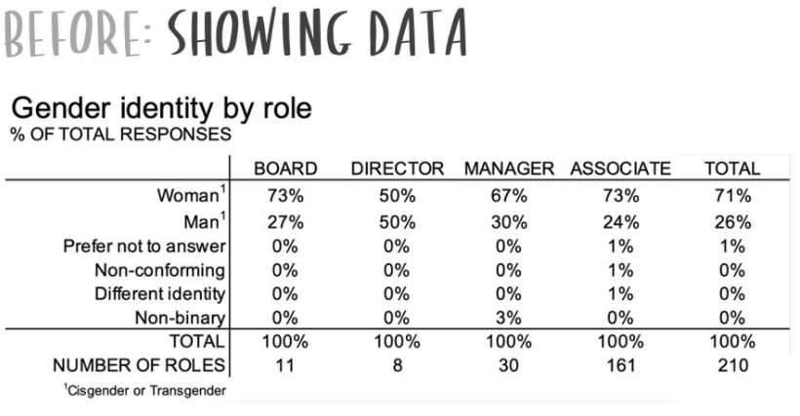

Slide 26
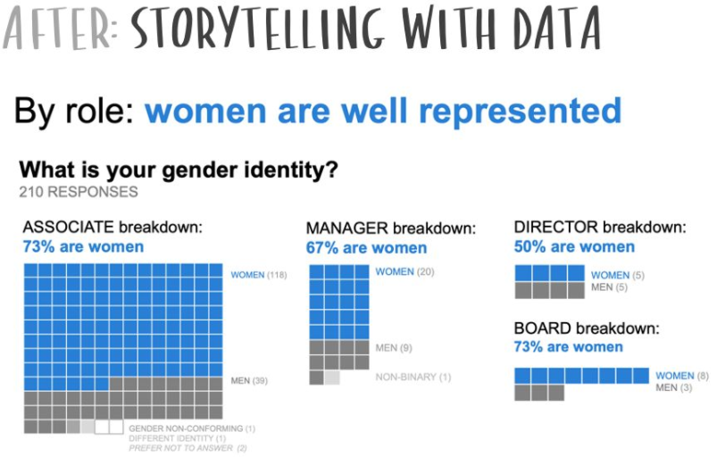

Slide 27
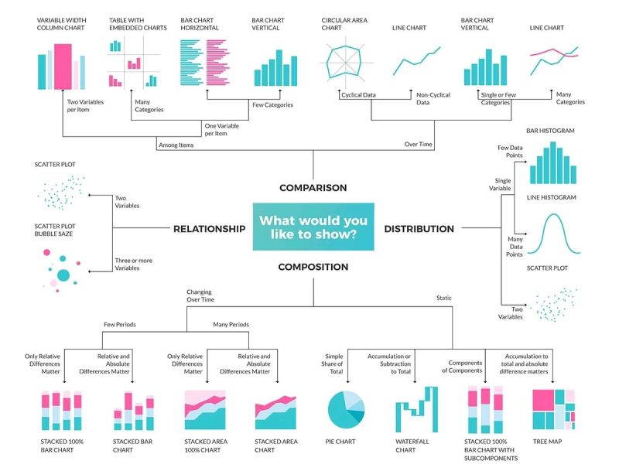

Slide 28










Data visualization providers

Slide 29
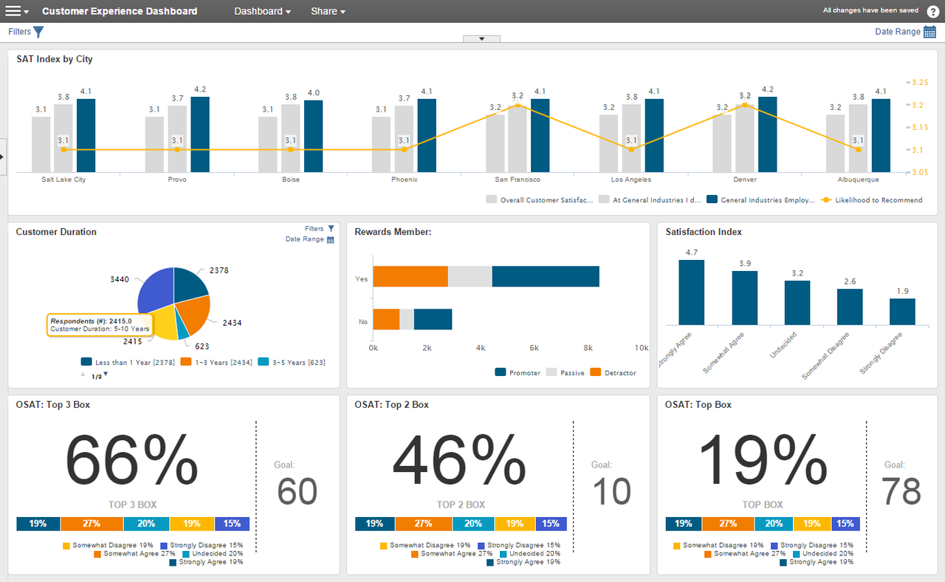

Slide 30
Bibliography
Bruce, P., & Bruce, A. (2017). Practical statistics for data scientists: 50 essential concepts. " O'Reilly Media, Inc.".
https://flowingdata.com/2015/12/15/a-day-in-the-life-of-americans/
https://www.gapminder.org/
https://www.opte.org/the-internet
Berengueres, A. F. J., & Sandell, M. (2019). Introduction to Data Visualization & Storytelling A Guide For The Data Scientist.
Frické, M. (2009). The knowledge pyramid: a critique of the DIKW hierarchy. Journal of information science, 35(2), 131-142.
MacLeod, H. (2009). Ignore Everybody: And 39 Other Keys to Creativity. Penguin.
https://www.merriam-webster.com/dictionary/narrative
https://www.ibm.com/cloud/learn/overfitting
http://www.tylervigen.com/spurious-correlations
https://scikit-learn.org/stable/modules/cross_validation.html
Elston, D. M. (2020). Data dredging and false discovery. Journal of the American Academy of Dermatology, 82(6), 1301-1302.
Schutt, R., & O'Neil, C. (2013). Doing data science: Straight talk from the frontline. Sebastopol, CA: O'Reilly.
Igual, L., & Seguí, S. (2017). Introduction to data science. Springer, Cham.
Skiena, S. S. (2017). The data science design manual. Springer.

